Slide 1

Product Intelligence AI
Automated Customer Review Analysis System
Turning unstructured customer reviews into actionable insights using NLP and AI

Slide 2

The Challenge
Volume Overload
Thousands of reviews across Reddit, YouTube, and HackerNews make manual analysis impossible
Slow Processing
Manual review takes days or weeks, delaying critical product decisions
Unscalable
As customer base grows, traditional methods cannot keep pace with data volume

Slide 3

Intelligent Solution
An automated system that transforms unstructured customer feedback into strategic product intelligence
01
Collect
Aggregate reviews from multiple platforms automatically
02
Analyze
Detect sentiment and extract key topics instantly
03
Generate
Produce AI-driven insights and recommendations
04
Report
Deliver actionable intelligence to stakeholders

Slide 4

System Architecture
A complete pipeline from raw data to strategic insights
AI Insight Engine
Data Sources
Generate strategic insights
Reddit, YouTube, HackerNews
End-to-End Data Pipeline
Web Scrapers
Topic Extraction
TF-IDF driven topics
Collect raw content
Sentiment Analysis
Text Cleaning
Transformer-based model
Normalize and filter text

Slide 5

Data Collection Layer
Multi-Source Aggregation
Reddit comments and posts
YouTube comment threads
HackerNews discussions
TrustPilot Reviews
Centralizes customer feedback from disparate platforms into unified analysis

Slide 6




NLP Processing Pipeline
Text Cleaning
Remove noise, normalize text, handle special characters
Sentiment Analysis
Transformer model classifies positive, negative, neutral tones
Topic Extraction
TF-IDF algorithm identifies recurring themes and features

Slide 7

AI Insight Engine
Intelligent Analysis
Generates comprehensive product intelligence reports with actionable findings:
Product strengths and advantages
Weaknesses requiring attention
Features customers love
Improvement suggestions
Transforms raw feedback into strategic product decisions

Slide 8
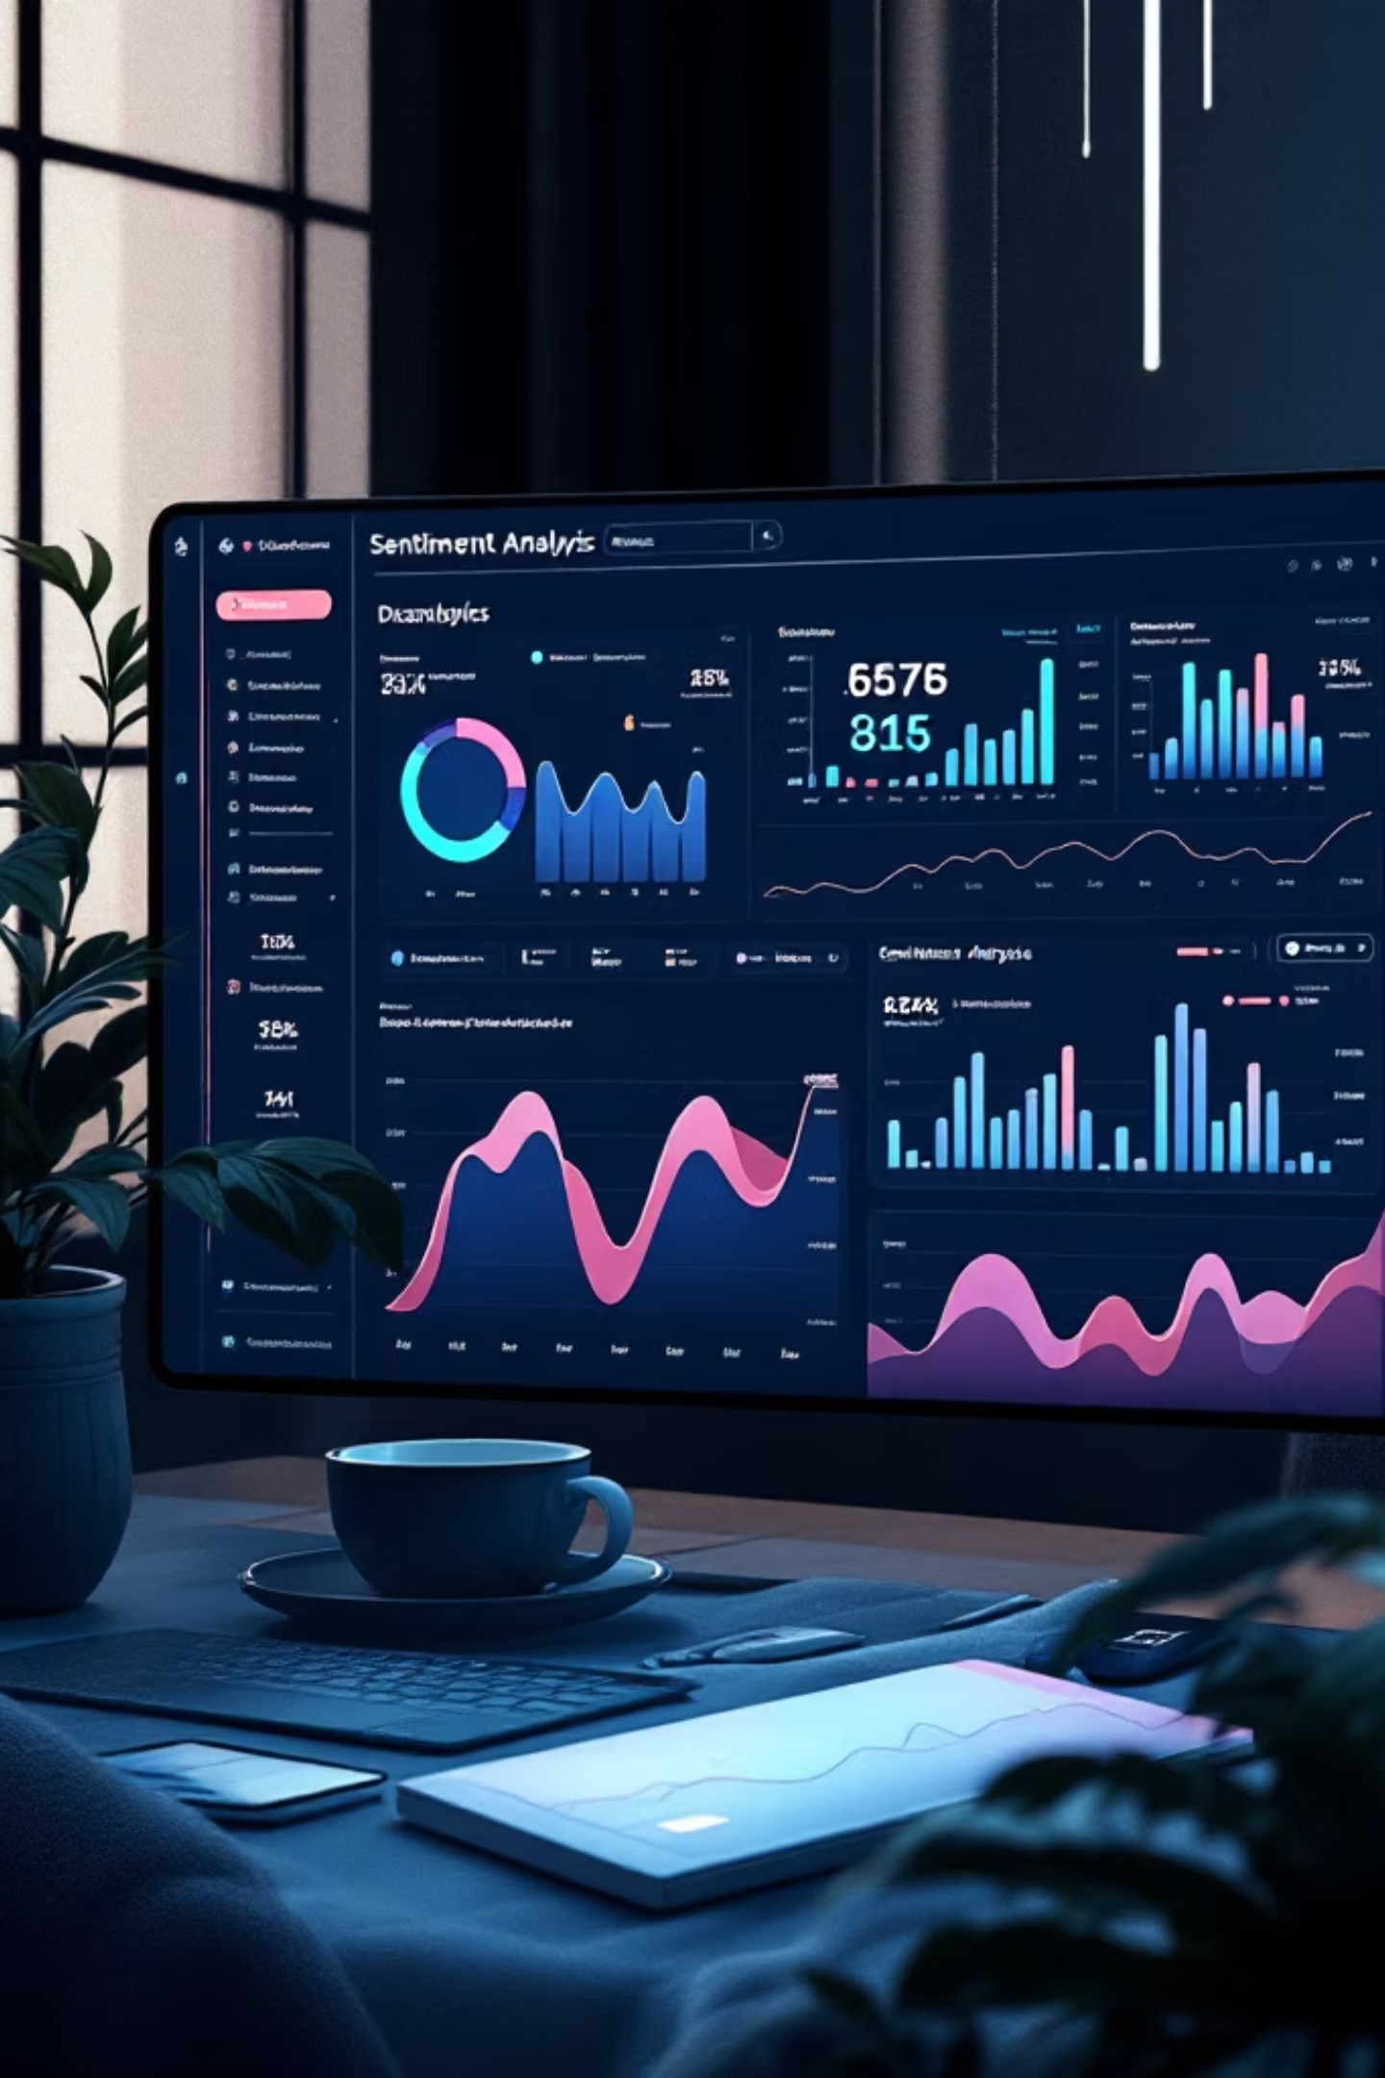
Example Output
Sentiment Distribution
Top Topics
68% Positive reviews
22% Negative feedback
10% Neutral observations
Performance, pricing, interface design, mobile compatibility, customer support responsiveness
Key Complaints
Slow loading times on mobile, limited free tier features, documentation gaps

Slide 9




Business Impact
Product Improvement
Feedback Monitoring
Identify pain points and prioritize feature development based on real customer feedback
Track customer sentiment trends and respond to emerging issues proactively
Competitive Analysis
Data-Driven Decisions
Benchmark against competitors and identify differentiation opportunities
Make strategic choices backed by quantitative customer intelligence

Slide 10

Future Enhancements
1
Real-Time Dashboards
Live sentiment tracking with instant alerts on emerging issues
2
Feature-Level Analysis
Granular sentiment breakdown by specific product features and components
3
Advanced Topic Modeling
Deep learning approaches for more nuanced theme detection
Product Intelligence AI transforms customer feedback into competitive advantage through automated analysis and strategic insights

